Slide 1
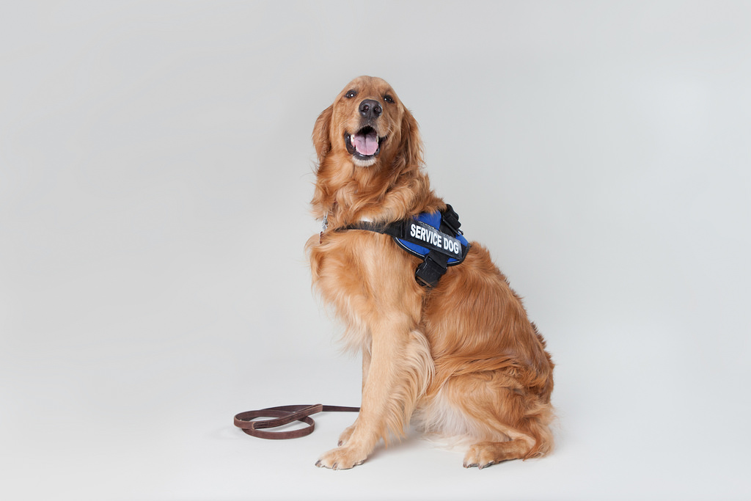
Service & Emotional Support Animals in Emergency Management

Slide 2
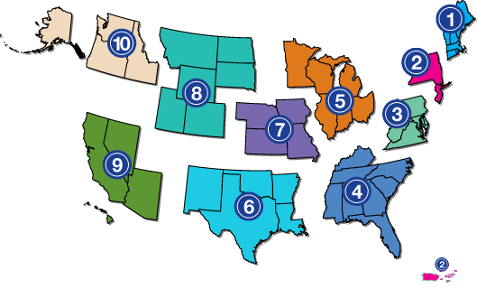
ADA National Network
1-800-949-4232 (V/Relay)
www.adata.org

Slide 3
Toll Free: 1-800-949-4232 (V/Relay) adatech@adapacific.org www.adapacific.org
Pacific ADA Center

Slide 4
Presentation Overview
How the laws address service animals and emotional support animals generally;
What laws and guidance documents help state or local government agencies recover funding expended on animal care from FEMA after a disaster; and
Best practices regarding service animals and emotional support animals for emergency managers, handlers with disabilities, and emergency shelter staff.

Slide 5
Overview of the ADA
ADA is a civil rights law
It has 5 titles
Title I - Employment
Title II – State & Local Governments
Title III – Public Accommodations & Commercial Facilities
Title IV - Telecommunications
Title V - Miscellaneous

Slide 6
Service and Emotional Support Animals Basic Knowledge

Slide 7
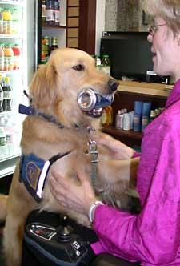
ADA Requirements
Virtually the same standards apply for Title II and Title III for the use of service animals.

Slide 8
Modification of Policy
Most state or local government and privately owned facilities have “no pet” policies and do not allow animals inside.
ADA Titles II and III require government and private facilities that are open to the public to allow service animals as a modification of that “no pet” policy.

Slide 9
Service Animal Access
Individuals with disabilities must be allowed to be accompanied by their service animals in all areas of facilities where members of the public are allowed to go, including goods, services, programs, or activities.
Unknown

Slide 10
“Service Animal” Definition
“Service animal means any dog that is individually trained to do work or perform tasks for the benefit of an individual with a disability, including a physical, intellectual, or other mental disability ……Companionship does not constitute work or tasks.”
NOTE: This is the U.S. Department of Justice definition.

Slide 11
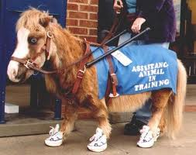
Miniature Horses
Allowed if
Reasonable
Individually trained
Assessment factors
Type, size, weight
Handler’s control
Whether housebroken
Safety requirements of facility

Slide 12
Work or Task of the Animal
The work must be directly related to the individual’s disability.
“Work” of the animal needs to be physical, but the disability does NOT need to be physical. It may be responding to “brain-based” impairments like psychiatric disabilities; e.g., “discerning distress” in someone who has anxiety.

Slide 13
“Work” or “Tasks”: Physical Disabilities
Examples of “work” or “tasks” for physical disabilities:
Navigation for individuals who are blind or low vision
Alerting Deaf/Hard of Hearing persons to other people and sounds
Retrieving items such as medicine or phone
Providing support and assistance with balance and stability
Assistance during a seizure

Slide 14
Physical tasks can include chest compressions for CPR.

Slide 15
“Work” or “Tasks”: Psychological / Emotional Disabilities
Examples of “work” or “tasks” for individuals with psychological or emotional disabilities
Prevent/interrupt impulsive or destructive behavior.
Help individual with dissociative identity disorder to remain grounded.

Slide 16
Emotional Support Animals
Although they are not covered by the ADA, emotional support animals (ESAs) can provide valuable support for people with certain types of disabilities.
An ESAs can be almost any type of animal (usually excluding exotic animals like large birds or certain reptiles).

Slide 17
Is Comfort or Companionship “Work” or a “Task”?
The definition of a service animal says, “no.” “The provision of emotional support, well-being, comfort, or companionship … [without more] does not constitute work or tasks for the purpose of this definition.”
The ability to “soothe” is not work.

Slide 18
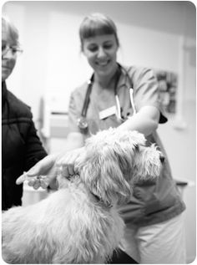
Registration & Vaccinations
Individuals who have service animals and emotional support animals (ESAs) are not exempt from local animal control or public health requirements.
In fact, service animals and ESAs
are subject to the same
licensing and vaccination rules
that apply to all animals.

Slide 19
What Proof Is Required for Service Animals?
A service animal is not required to wear a
special collar, harness, or tag.
A service animal is not required to have
papers or a certificate regarding its training.

Slide 20
What Proof Is Required for Emotional Support Animals?
A letter from a licensed medical or rehabilitation professional is required for emotional support animals in housing and homeless shelters.
The letter must say what the connection is between the person’s disability and the need for the emotional support animal.

Slide 21
Two Questions Can Be Asked
You can ask a service animal handler:
Is this a service animal required because of disability?
What specific tasks or work has the animal been trained to perform?
Cannot inquire about the nature of the handler’s disability or ask to see the task performed

Slide 22
Service Animal Control
A service animal must be under the control of its handler.
A service animal must have a harness, leash, or other tether, unless
the handler is unable because of a disability to hold the harness, leash or tether, or
the harness, leash or tether would interfere with the service animal’s safe, effective performance of work or tasks,
If one of the above exceptions applies, the service animal must be otherwise under the handler’s control (e.g., voice control, signals, or other effective means).

Slide 23
Service Animal Conduct
An entity covered by ADA may ask an individual with a disability to remove a service animal from the premises if—
the animal is out of control and
the animal’s handler does not take effective action to control it or
the animal is not housebroken
The handler can return without
the animal.
This Photo by Unknown Author is licensed under CC BY-SA-NC

Slide 24
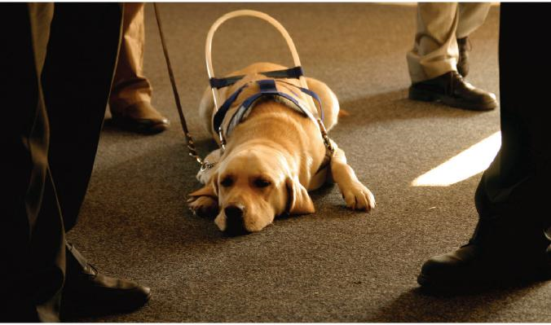
Service Animal Behavior
With legitimate service animals, you should hardly be aware they are present.

Slide 25
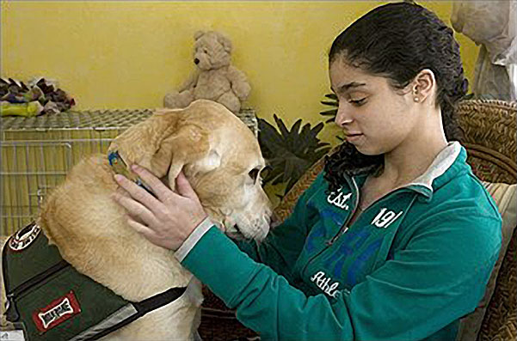
Surcharge/Fees
A shelter or other entity covered by the ADA may not charge a deposit, surcharge, an advanced or unequal cleaning fee or any other fee to an individual with a disability as a condition to allowing the service animal to accompany the individual.

Slide 26
Interacting with Service Animals
Service animals are working.
Do not pet, feed or speak to a service animal.

Slide 27
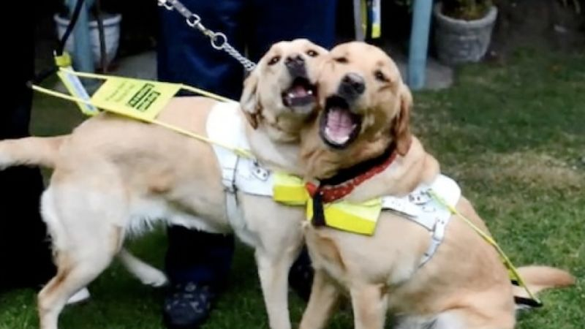
Number of Service Animals
There is technically no limit on the number of service animals a person can use
It needs to be reasonable
Each service animal would need to do a task that can be described

Slide 28
Dog Breeds
Service animals may not be restricted or excluded based on their breed
The key is the service animal’s behavior or conduct

Slide 29
Service Animals In Training
ADA does not cover service animals in training.
Look at your state law for coverage.

Slide 30
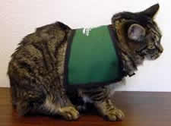
Other Animals
Animals other than dogs and miniature horses may be allowed in non-emergency shelters because the Fair Housing Act applies in addition to the ADA.
Emotional support animals
are not allowed in emergency
shelters

Slide 31
ADA Defenses Regarding Service Animals
Fundamental Alteration
A service animal could “fundamentally alter” the nature of the services provided (e.g., at a zoo where it disturbs other animals)
Direct Threat
The service animal could pose a “direct threat” to the health or safety of others that cannot be reduced or eliminated by another reasonable modification.

Slide 32
Laws and Guidelines That Apply to Service Animals, Emotional Support Animals and Pets

Slide 33
Establishing FEMA
The Federal Emergency Management Agency (FEMA) was established in 1979 under President Jimmy Carter.
In 2003, FEMA became part of the U.S. Department of Homeland Security.

Slide 34
FEMA Service Animal Definition
Same as U.S. Department of Transportation ADA Definition
“Any guide dog, signal dog, or other animal individually trained to provide assistance to an individual with a disability, including, but not limited to, guiding individuals with impaired vision, alerting individuals with impaired hearing to intruders or sounds, providing minimal protection or rescue work, pulling a wheelchair, or fetching dropped items.” [emphasis added]

Slide 35
National Response Framework
A document that establishes a comprehensive, national, all-hazards approach to emergency response.
Identifies the key response principles, roles and structures that organize a national response.
Describes how communities, Tribes, States, the Federal Government and private-sector nongovernmental partners apply key response principles for a coordinated and effective nationwide response.

Slide 36
Robert T. Stafford Disaster Relief and Emergency Assistance Act
Known as the Stafford Act.
Federal law designed to bring an orderly and systematic means of federal natural disaster assistance for tribal, state and local governments in carrying out their responsibilities to aid citizens.
Passed in 1988.

Slide 37
Things Changed After Hurricane Katrina
After Hurricane Katrina hit New Orleans and the Gulf Coast in 2005, several significant failures led to changes in:
unified management of the national response;
command and control structures within the Federal government;
knowledge of tribal, state and local preparedness plans; and
regional planning and coordination

Slide 38
Post-Katrina Emergency Management Reform Act (PKEMRA)
Amendment to Stafford Act to designate FEMA as the sole primary federal agency for emergency response.
Directs FEMA to appoint a Disability Coordinator to ensure that the needs of individuals with disabilities are addressed in emergency preparedness and disaster relief.
Allows FEMA to ensure and reimburse pet and service animal rescue and shelter expenses with help from other agencies.
Passed in 2006.

Slide 39
Pets Evacuation and Transportation Standards Act (PETS Act)
Amends the Stafford Act
Ensures that state and local emergency preparedness operational plans address the needs of individuals with household pets, service animals, and ESAs following a major disaster or emergency.
Passed in 2006.

Slide 40
Who Uses the PETS Act?
Non-profits and private companies – Nongovernmental Organizations (NGOs) who can provide animal rescue, evacuation and shelter and enter into Memoranda of Understanding (MOUs) to provide these services.
State and local governments who seek reimbursement for providing animal rescue, evacuation and shelter directly or through contracts/MOUs with NGOs.

Slide 41
When the PETS Act Becomes Operational
The PETS Act becomes operational when a federal disaster declaration is made.
The Presidential declaration serves as a "trigger" that provides for reimbursement for allowable, documented, services used in the declared disaster event.

Slide 42
How the PETS Act Works
FEMA developed a Disaster Assistance Policy (DAP) titled "Eligible Costs Related to Pet Evacuations and Sheltering” (DAP 9523.19)
DAP 9523.19 provides specific guidelines on expenses that are - or are not - reimbursable to states that have costs related to animals in a disaster.

Slide 43
DAP 9523.19 Eligible Costs
Says that service animals will be sheltered with their owners in congregate shelters.
Eligible costs include those that state and local governments incur for rescue, sheltering, and evacuation support.
Provides a process for NGOs who incur the same eligible costs to seek reimbursement from government agencies with whom they have MOUs.

Slide 44
Comprehensive Preparedness Guide 101 Supplement
FEMA Household Pet and Service Animal Planning (HPSAP) Checklist
Guide to integration of household pet and service animal issues into a government’s existing emergency operations plan.

Slide 45
Sections of the HPSAP Checklist
Preparedness (including training)
Evacuation Support (including transportation)
Animal Shelter Operations
Registration and Animal Intake
Animal Care
Public Information and Outreach (about animal shelters)
Record Keeping (for cost reimbursement)

Slide 46
Service and Emotional Support Animal Best Practices: Emergency Managers

Slide 47
Consider Animals at All Stages of a Disaster
Include service animals, ESAs and pets in evacuation, response, and recovery plans.
Have agreements in place before disasters with private Nongovernmental Organizations (NGOs) who can provide evacuation and shelter assistance for pets, ESAs and service animals.
Know what documentation is required to get federal reimbursement under the PETS Act.

Slide 48
Train Staff and Involve Your ADA Coordinator
Train your staff on the laws that cover service animals, ESAs and pets.
Ensure emergency shelter staff receive the same training.
Make a point to involve your ADA Coordinator in your Emergency Operations Plan and Center.

Slide 49
Service and Emotional Support Animal Best Practices: Handlers with Disabilities

Slide 50
Plan for Emergencies
Have an evacuation plan for you and your animals.
Know where you will need to go to seek shelter – your service animal will be able to come with you.
Identify separate shelters for emotional support animals and pets in advance.

Slide 51
Evacuation Drills
Make sure your service animal or ESA is included in any evacuation drills you participate in, including those in:
Housing
Workplaces
Shelters
Public buildings

Slide 52
Emergency Kits for Animals
Service and ESA handlers should carry supplies in “go bags” for their animals as well as themselves in an emergency
Food and water
Medication the animal takes
Bowls for water and food
ID tags and veterinary records
Pet shampoo, wipes, small bags, and other items used to clean up after the animal
Blanket for sleeping and favorite toy
Leash or harness

Slide 53
Service and Emotional Support Animal Best Practices: Shelters

Slide 54
Excluding an Animal from A Shelter
Excluding an animal that the handler identifies as their service animal can be complex in an emergency or disaster situation.
Where can the animal be placed?
You may want to limit exclusion to times where an animal’s behavior poses a direct threat to the health or safety of others.
This must be based on substantial risk of actual harm and not on potential risk or generalizations.

Slide 55
Train Shelter Staff
Train shelter staff on –
Basic rules on service animals and emotional support animals.
Location of animal shelters that can care for emotional support animals and pets if needed.

Slide 56
Create Space for Service Animals
Within shelters, create space where people who bring their service animals can have the animal next to them.
If another shelter resident has dog allergies, try to separate them.

Slide 57
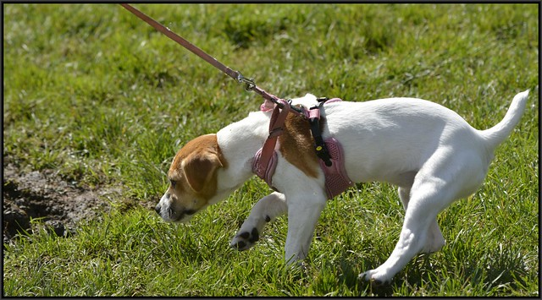
Service Animal Relief Areas
Emergency shelters should have grassy areas that can be used for service animals to relieve themselves.

Slide 58
Care and Supervision
Staff are not responsible for the care and supervision of service animals.
If a person who uses a service animal cannot care for them independently while in the shelter, staff should try to locate family or friends of the handler or recruit a shelter volunteer if one is consistently available.
Emergency pet shelters are set-up in a disaster and can care for service and emotional support animals as well as pets.

Slide 59
Resources I
Pacific ADA Center Emergency Preparedness
https://www.adapacific.org/emergency-preparedness-publications-resources
ADA National Network Service Animals in Emergency Situations
https://adata.org/service-animal-resource-hub/emergencies

Slide 60
Resources II
U.S. Department of Justice Service Animal FAQ
https://www.adapacific.org/assets/documents/usdoj-service-animal-faq.pdf
Post Katrina Emergency Management Reform Act (PKEMRA) Summary
https://emilms.fema.gov/is_0822/groups/20.html
PETS Act FAQ
https://www.avma.org/pets-act-faq

Slide 61
Resources III
FEMA Disaster Assistance Policy 9523.19
https://alert.ny.gov/system/files/documents/2018/12/eligible-costs-related-pet-evacuation-femadisaster-policy.pdf
FEMA Comprehensive Preparedness Guide 101 Supplement Household Pets and Service Animal Planning Checklist
https://www.fema.gov/pdf/about/divisions/npd/CPG_101_Supplement_HPSA.pdf

Slide 62
Thank you!

